Slide 1


Major Project-I
Environment and Climate Prediction Model
Presented by:
Kanishk Kapoor, 500084115, CSE CSF
Guided by:
Dr. Shamik Tiwari
School of Computer Science

Slide 2
Content
Introduction
Problem Statement
Motivation
Objectives
Tech Stack
Methodology
PERT Chart
Swot Analysis
Implementation
References

Slide 3
1. Introduction
ECP model is an essential tool that enable scientists, policymakers, and the general public to anticipate and prepare for the complex and ever-changing patterns of weather and climate.
This ECP model offers an entry point for individuals who are not necessarily experts in climatology or meteorology but are interested in understanding and engaging with climate forecasts. This model distills the fundamental principles of meteorology and climate science into user-friendly algorithms, allowing for relatively straightforward predictions of weather patterns and broader climate trends. This model can be particularly valuable for educational purposes, public outreach, and community-based decision-making, as they bridge the gap between complex scientific concepts and practical applications.
By focusing on essential meteorological variables and employing a simplified algorithmic approach, this model allows individuals to grasp the core mechanisms driving weather changes and anticipate shifts in broader climatic conditions. Through its straightforward methodology and intuitive outputs, the model offers a starting point for non-experts to engage with climate prediction, fostering a more climate-literate society.

Slide 4
2. Problem Statement
We are designing and implementing an environment and climate prediction model that can accurately forecast prolonged effect of emissions affecting environment and climate. This study shall focus on the impact of Carbon emissions in the nation.
This model will leverage the latest advancements in data science, machine learning, and computational methods to provide reliable predictions, aiding in better decision-making and planning across various sectors.

Slide 5
3. Motivation
This project is motivated by the urgent need to understand and predict the complex interactions within Earth's climate and ecosystem that is influencing quality of life in the nation.
By developing accurate models, scientists can anticipate the impacts of climate change, such as rising carbon emissions which further influences high temperatures, extreme weather events, and sea level rise.
These models inform policy decisions, aid in planning for adaptation and mitigation strategies, and contribute to a better understanding of the planet's future environmental conditions.

Slide 6
4. Objectives
This model’s primary objective is to understand changes and comprehend the historical data of carbon emissions over varying time scales that have or will have substantial impact on quality of life across various cities.
Secondly, by analyzing historical data and making future predictions, the model helps researchers and scientists better understand the complex interactions and dynamics of the Earth's climate system. This understanding contributes to advancing climate science and identifying trends and anomalies.

Slide 7


5. Technology Stack
Version Control:
Git
Tools used:
Python programming Language (Base)
Spyder(data science visualization IDE)
Model Used:
ARIMA(Auto Regressive Intermediate Moving Average)
ARMA

Slide 8
6.1 Methodology
It involves the use of mathematical and computational techniques to make predictions about future carbon and other emissions based on historical data and scientific understanding of the Earth's climate system. This type of modeling plays a crucial role in assessing potential impacts of climate change and in developing strategies for mitigation and adaptation. Here's a general overview of the methodology behind carbon emissions predictive modeling
Data Collection and Preprocessing: Gather historical climate data, which includes emissions , state wise share of emissions, temperature, etc. Collect data from various sources such as weather stations, satellites, ocean buoys, and climate models. Clean and preprocess the data to remove outliers, correct errors, and fill in missing values.
Check for stationary datasets: Check stationarity of data sets using Dickey Fuller Algorithm, and eliminate any trends by transforming the non-stationary data using unit-root or differencing methods.
Identify ARIMA Parameters: To get the optimum results , find out the best p,q, and d values that holds the least value of ACF and PACF.
Model Calibration and Validation: Divide and run the model on train-test splits to a prior date for validating the forecast results.

Slide 9
6.2 Methodology(contd.)
Scenario Development: Define different scenarios of greenhouse gas emissions, land use changes, and other relevant factors that influence the climate. These scenarios help represent a range of potential future conditions, from business-as-usual to more sustainable pathways.
Model Simulation: Run the calibrated climate models using the defined scenarios to simulate the future climate conditions under various circumstances. Model simulations may cover short-term predictions (e.g., seasonal forecasts) or long-term projections (e.g., century-scale climate change).
Analysis and Interpretation: Analyze the model outputs to identify trends, patterns, and potential changes in various climate variables. Interpret the results in the context of the defined scenarios to understand the potential impacts of different policy decisions or environmental changes.
Uncertainty Assessment: Climate predictions involve inherent uncertainties due to the complexity of the climate system and limitations in data and models. Quantify and communicate uncertainties associated with model outputs to provide policymakers and the public with a more complete picture.
Feedback and Iteration: Continuously refine and improve the models based on new data, scientific advancements, and feedback from the broader scientific community. Iterate through the calibration, validation, and simulation steps to enhance the accuracy of predictions.
Policy and Decision Support: Provide climate predictions and projections to policymakers, researchers, and other stakeholders to inform policy decisions and adaptation strategies.

Slide 10
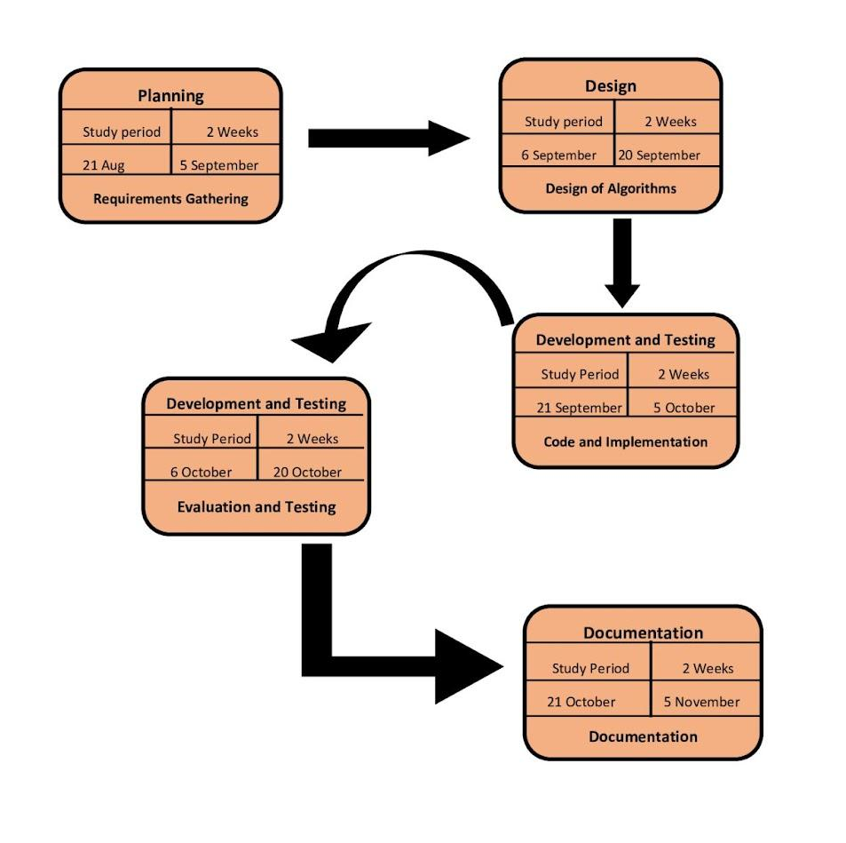
7. PERT Chart
Fig: Program Evaluation Review Technique Chart

Slide 11
8. SWOT analysis
STRENGTHS
WEAKNESS
Long-term Planning
Research and Innovation
Public Awareness
Customization
Complexity
Uncertainty
Assumption Sensitivity
Data Quality.
OPPORTUNITY
THREATS
Data Privacy
Economic Factors
Climate Change Complexity
Policy Alignment
Technological Advances
Climate Finance

Slide 13
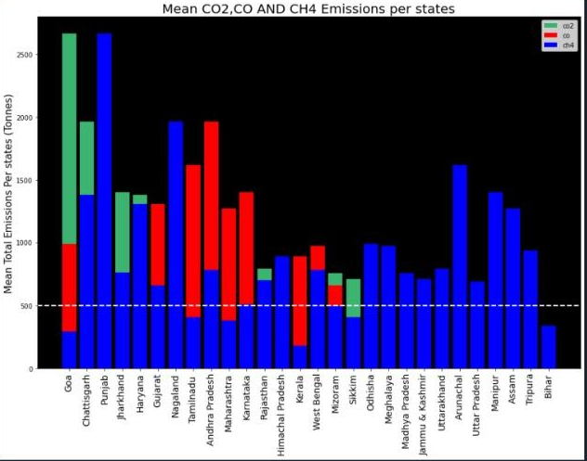
9. Implementation
Figure 1. Carbon Emissions Overview across states

Slide 14
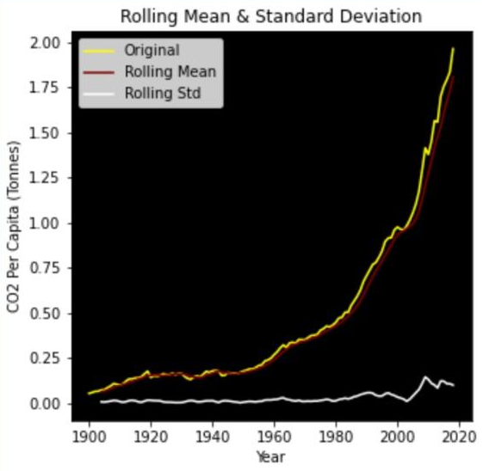
Figure 2. Rolling mean and Standard Deviation

Slide 15
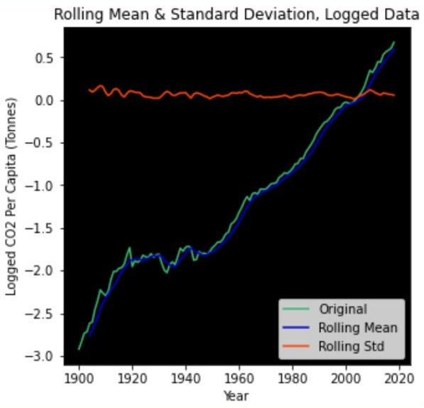
Figure 3. Rolling Mean & Standard Deviation of Logged data

Slide 16
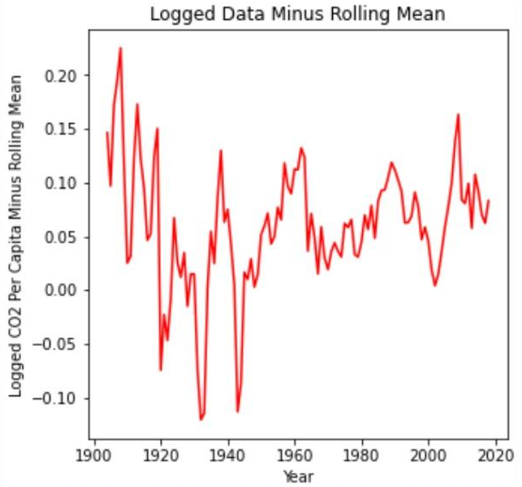
Figure 4. Logged CO2 per capita minus rolling mean

Slide 17
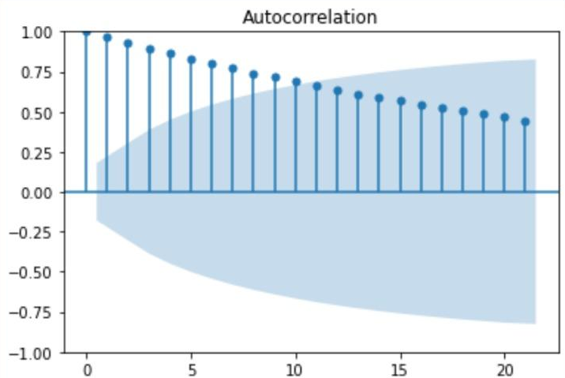
Figure 5. Autocorrelation

Slide 18
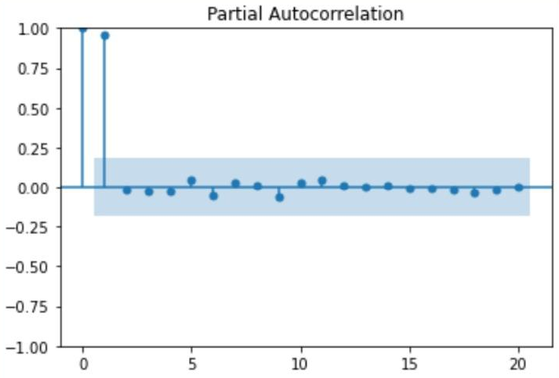
Figure 6. Partial Autocorrelation

Slide 19
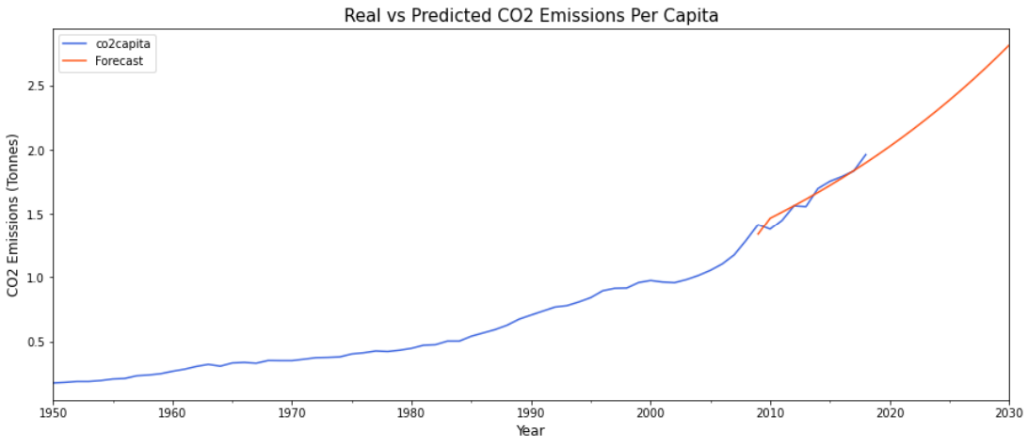
10. Result
Figure 7. CO2 Emissions vs Year

Slide 20
10. References
IPCC AR5 (2013): Chapter 9 provides an overview of climate models and their Performance: https://www.ipcc.ch/report/ar5/wg1/
CESM (Community Earth System Model): A widely used ESM developed by the National Center for Atmospheric Research (NCAR). Website: http://www.cesm.ucar.edu/
PMIP (Paleoclimate Modeling Intercomparison Project): A project focused on comparing and improving paleoclimate simulations. Website: https://pmip.lsce.ipsl.fr/
ERA5 (Fifth generation of the European Centre for Medium-Range Weather Forecasts Reanalysis): Information available at: https://www.ecmwf.int/en/forecasts/datasets/reanalysis-datasets/era5

Slide 21
Thank You

